Slide 1

Proposed Driscoll Expansion
Brookline, Massachusetts
Transportation Impact Assessment
Prepared by:
January 28, 2019

Slide 2
Traffic Agenda Items
Area of Study
Existing Conditions
Traffic Generation
Recommendations

Slide 3
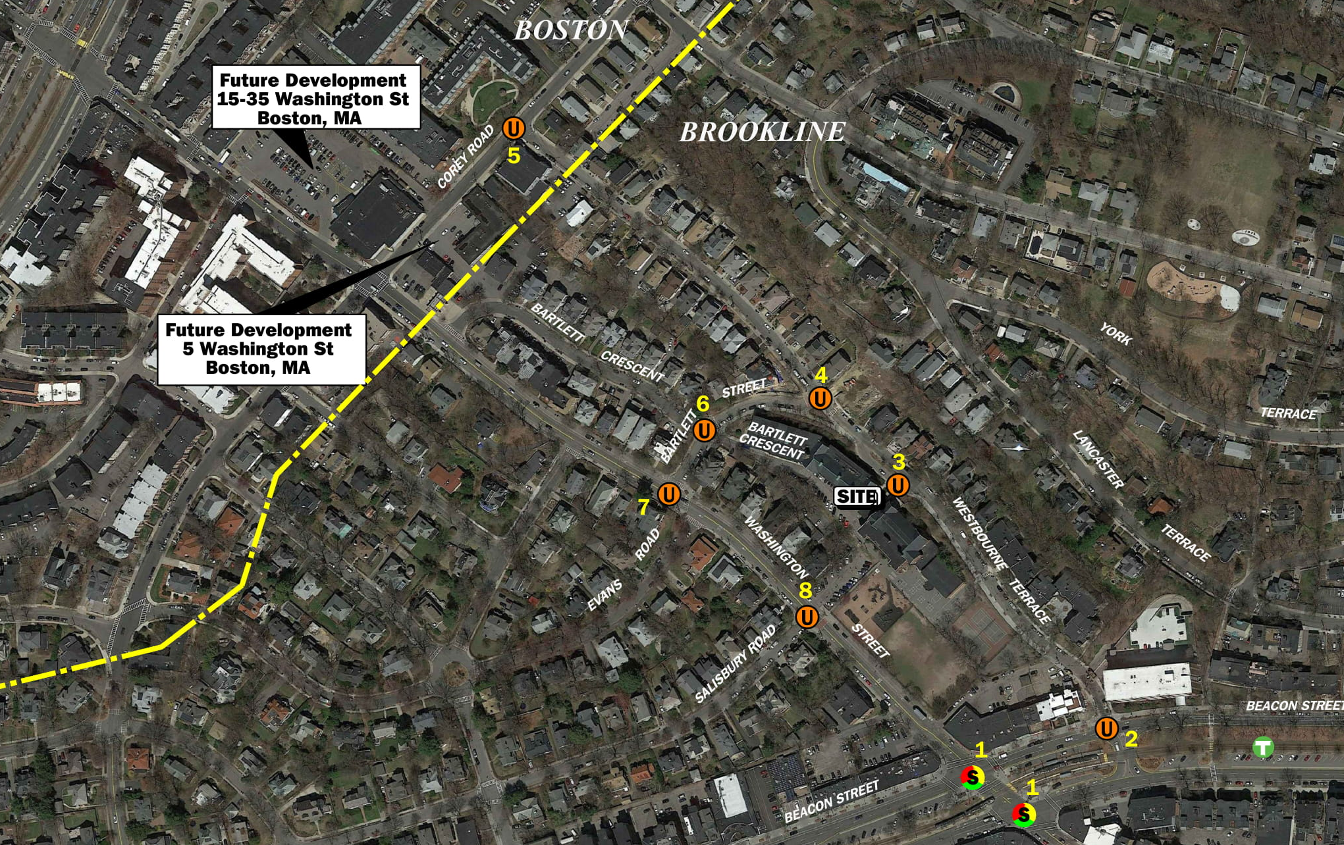
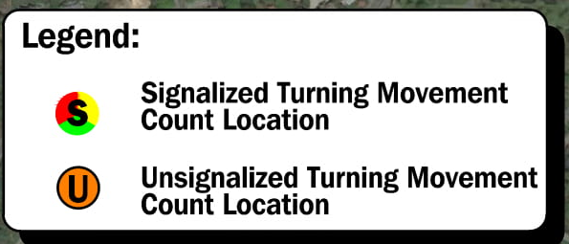
Site Location and Study Area Map

Slide 4
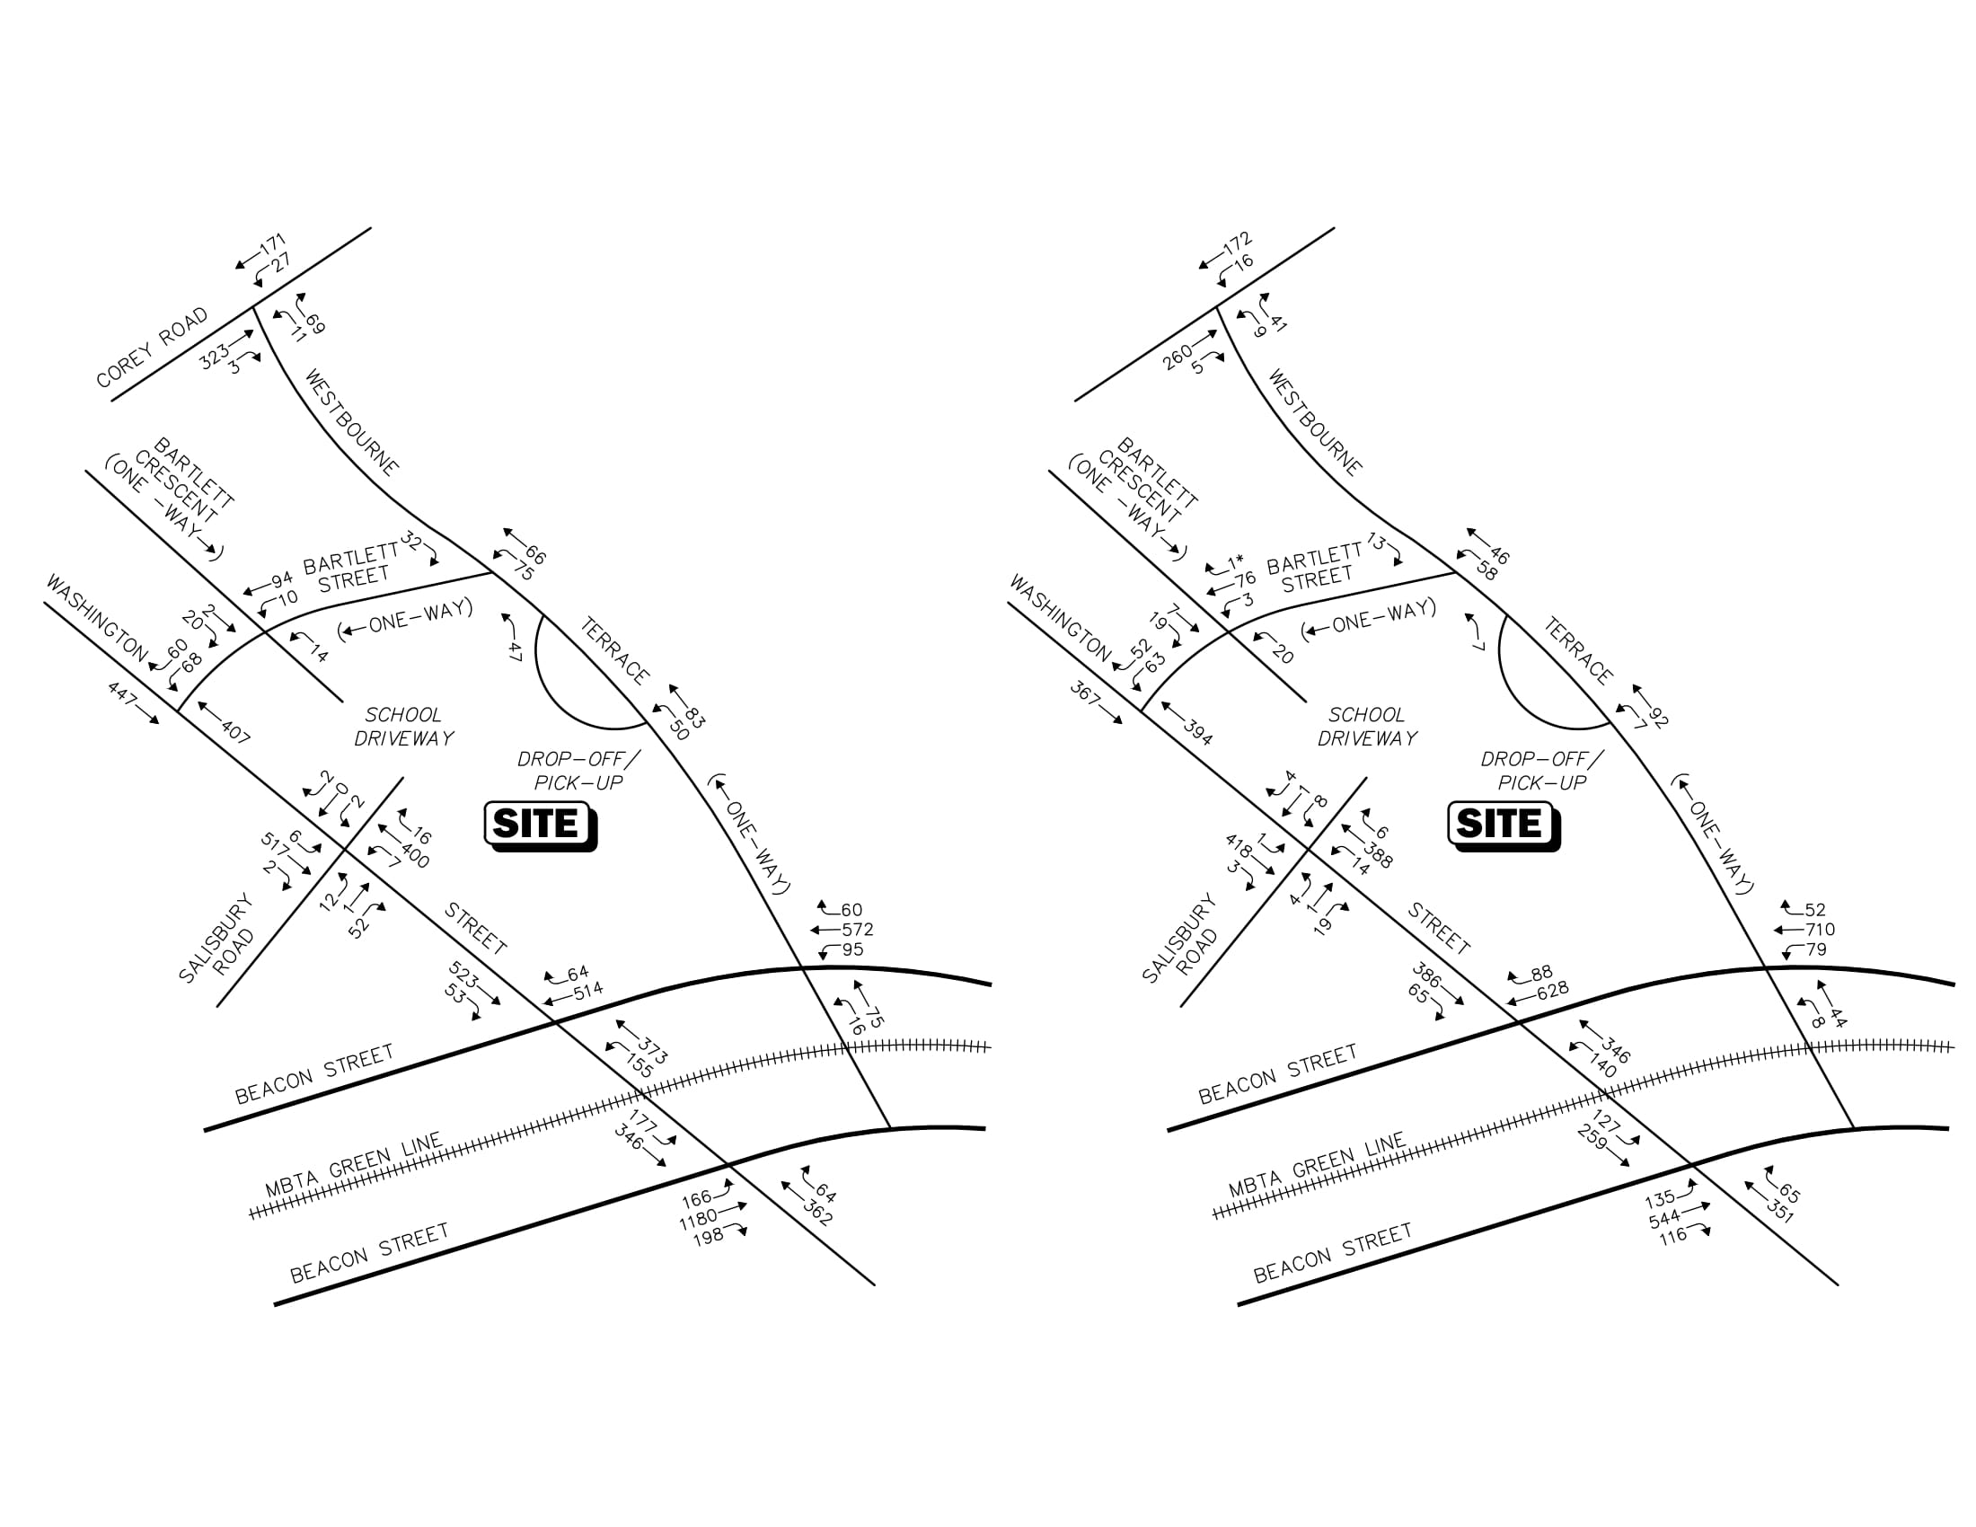
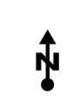
2018 Existing Conditions – Weekday Morning
School Peak Hour Traffic Volumes ( 7:30-8:30 AM)
 | School Driveways
Time Period | Westbourne Terrace Driveway | Bartlett Street Driveway and Washington Street Driveway
Weekday Morning Peak Hour: Entering Exiting Total | 50 47 97 | 33 12 45
Note: - Imbalances exist due to numerous curb cuts and side street that are not shown.
- Numbers indicate vehicles at intersections during a one hour period.

Slide 5
2018 Existing Conditions – Weekday Afternoon
School Peak Hour Traffic Volumes ( 2:00-3:00 PM)
 | School Driveways
Time Period | Westbourne Terrace Driveway | Bartlett Street Driveway and Washington Street Driveway
Weekday Afternoon Peak Hour: Entering Exiting Total | 7 7 14 | 12 29 41
Note: - Imbalances exist due to numerous curb cuts and side street that are not shown.
- Numbers indicate vehicles at intersections during a one hour period.

Slide 6
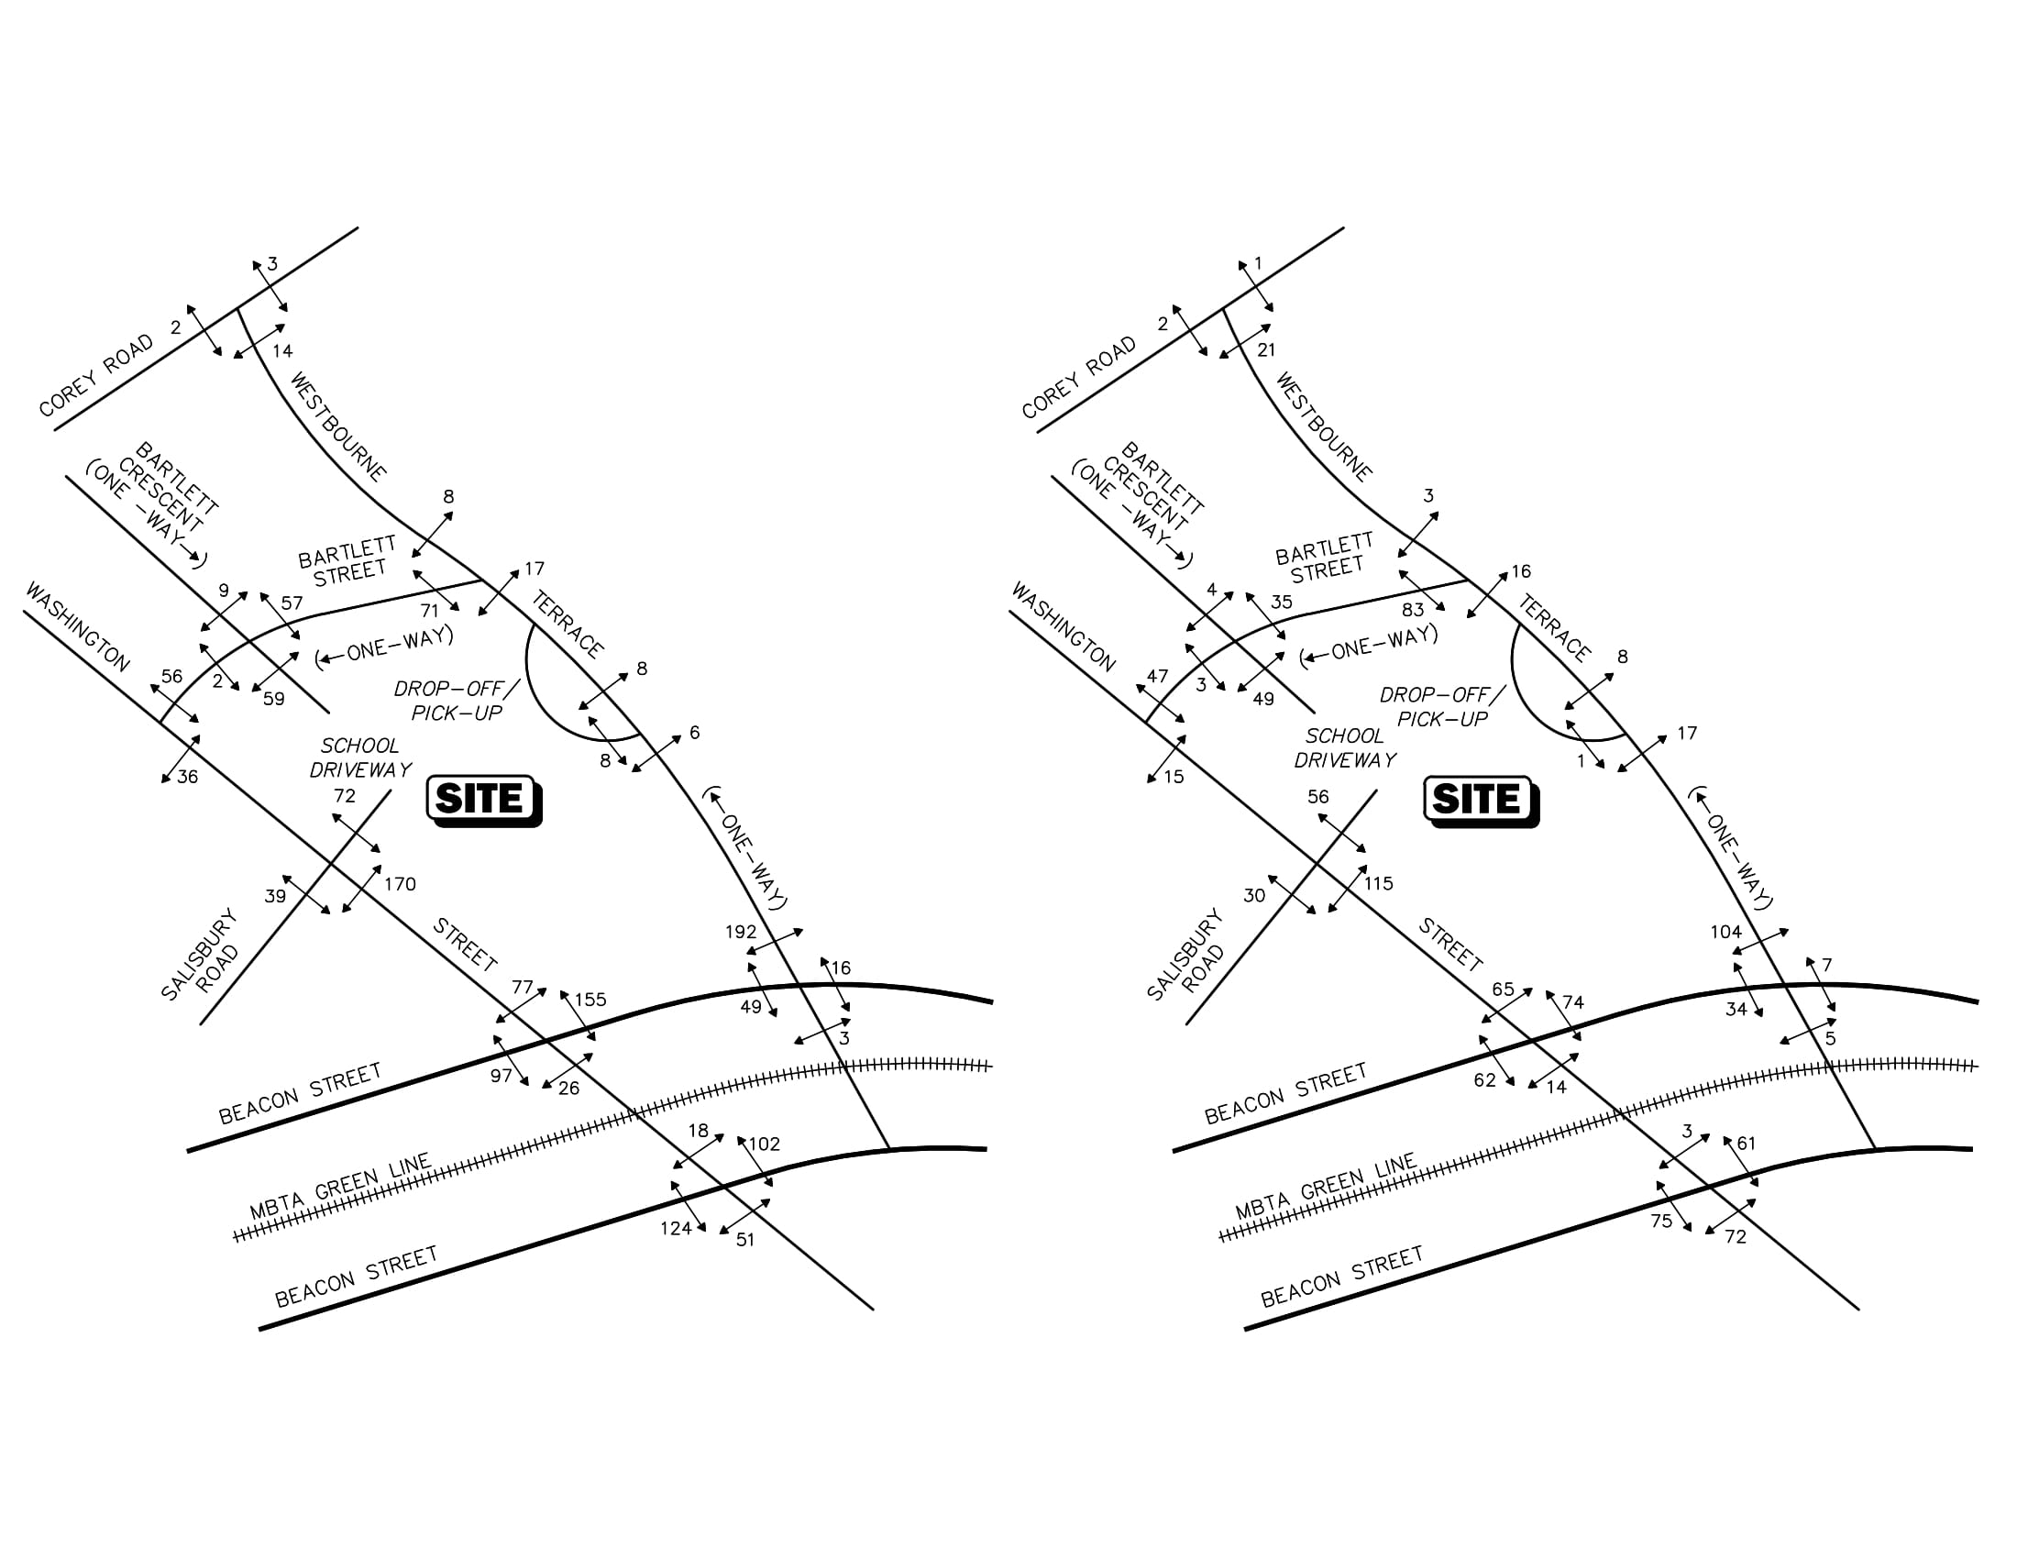
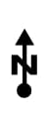
2018 Existing Conditions – Weekday Morning
School Peak Hour Pedestrian Volumes ( 7:30-8:30 AM)
Note: Numbers indicate both school and non school pedestrians during a one hour period.

Slide 7
2018 Existing Conditions – Weekday Afternoon
School Peak Hour Pedestrian Volumes ( 2:00-3:00 PM)
Note: Numbers indicate both school and non school pedestrians during a one hour period.

Slide 8
Trip Generation Summary
 | Existing Condition
 | School Driveways |  |  | On-Street Parking Drop-Off/ Pick-Up
Time Period | Westbourne Terrace Driveway | Bartlett Street Driveway and Washington Street Driveway |  | Washington Street | Bartlett Street | Westbourne Terrace | Staff | Total Trips (632 Students) ¹ | New Trips 800 Students² | Increase³
Weekday Morning Peak Hour: Entering Exiting Total | 50 47 97 | 33 11 45 |  | 25 25 50 | 21 21 42 | 15 15 30 | 45 0 45 | 189 120 309 | 246 156 402 | 57 36 93
Weekday Afternoon Peak Hour: Entering Exiting Total | 7 7 14 | 12 29 41 |  | 11 11 22 | 13 13 26 | 26 26 52 | 0 10 10 | 69 96 165 | 90 125 215 | 21 29 50
¹ Numbers Represent – Staff, Buses and Parent Vehicles.
² Note: 26% increase in Students. Assume 30% increase in Traffic.
³ Increase includes staff and student drop-off/pick up.

Slide 9
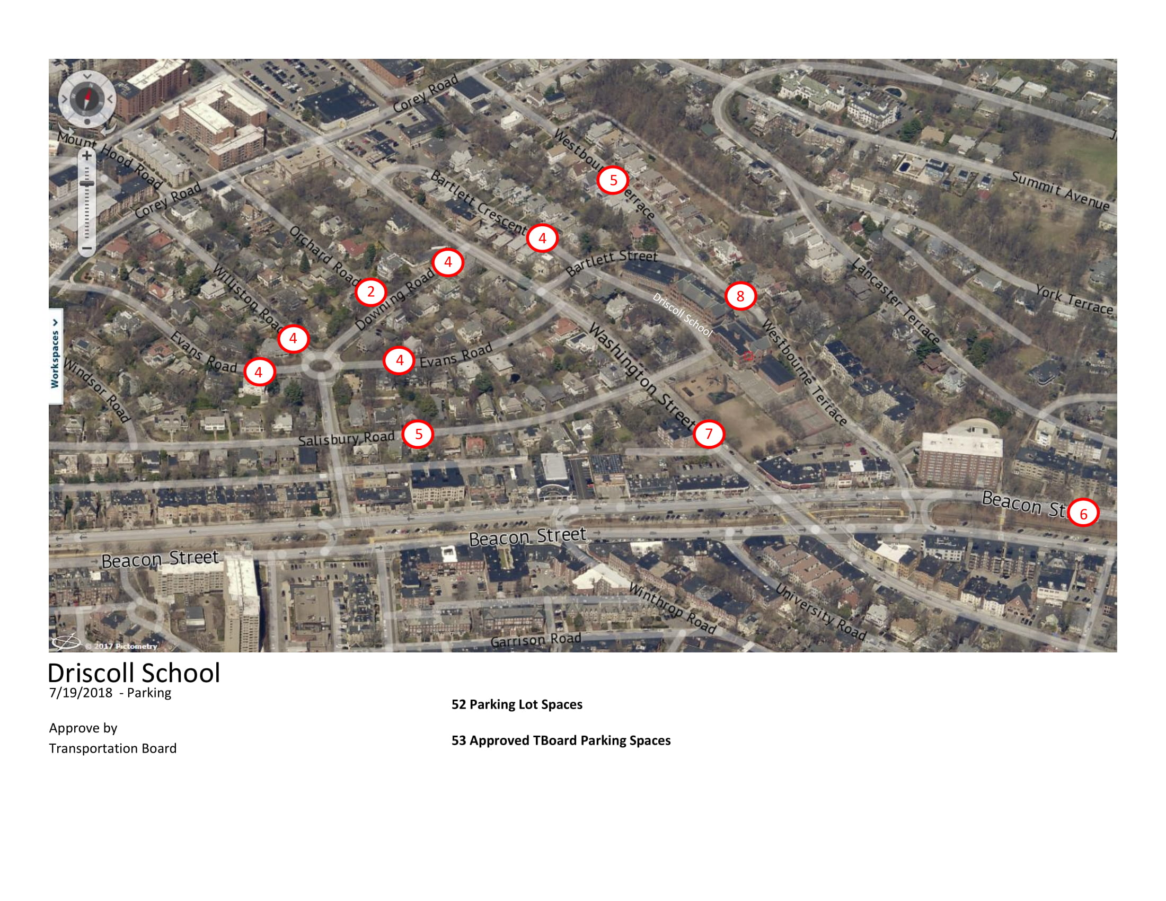
Teachers On-Street Parking - Existing

Slide 10
Recommendations
Project Area Access
Main Driveway Off Washington Street
A Bus Drop-off Area Off Washington Street
Parent Drop-Off along Westbourne Terrace and Washington Street
  Off-Site
Crossing Guards
Salisbury Road
Area Sidewalk Upgrades
Washington Street
Westbourne Terrace
  School Drop-Off and Pick-Up Traffic Management Plan
School Staff Should Be Stationed at The Drop-off
A Designated Drop-off/Pick-up Area
Encourage Carpooling
Parents and Caregivers Will Be Given Information on School Drop-off and Pick-up Times and Procedures

Slide 11
Recommendations
  School Zone Signage
Washington Street
Westbourne Terrace
  Bicycle Considerations
  Bicycle Racks Should Be Provided – Interior/Exterior
  Shower Facilities
  Transit Usage
Promote staff usage
Town TDM plan
  Traffic Monitoring
  Within three months after school opening and annually
Pedestrian safety
Crossing guards
  Construction Management Plan
  A detailed Construction Management Plan should be prepared and reviewed by the Town

Slide 12
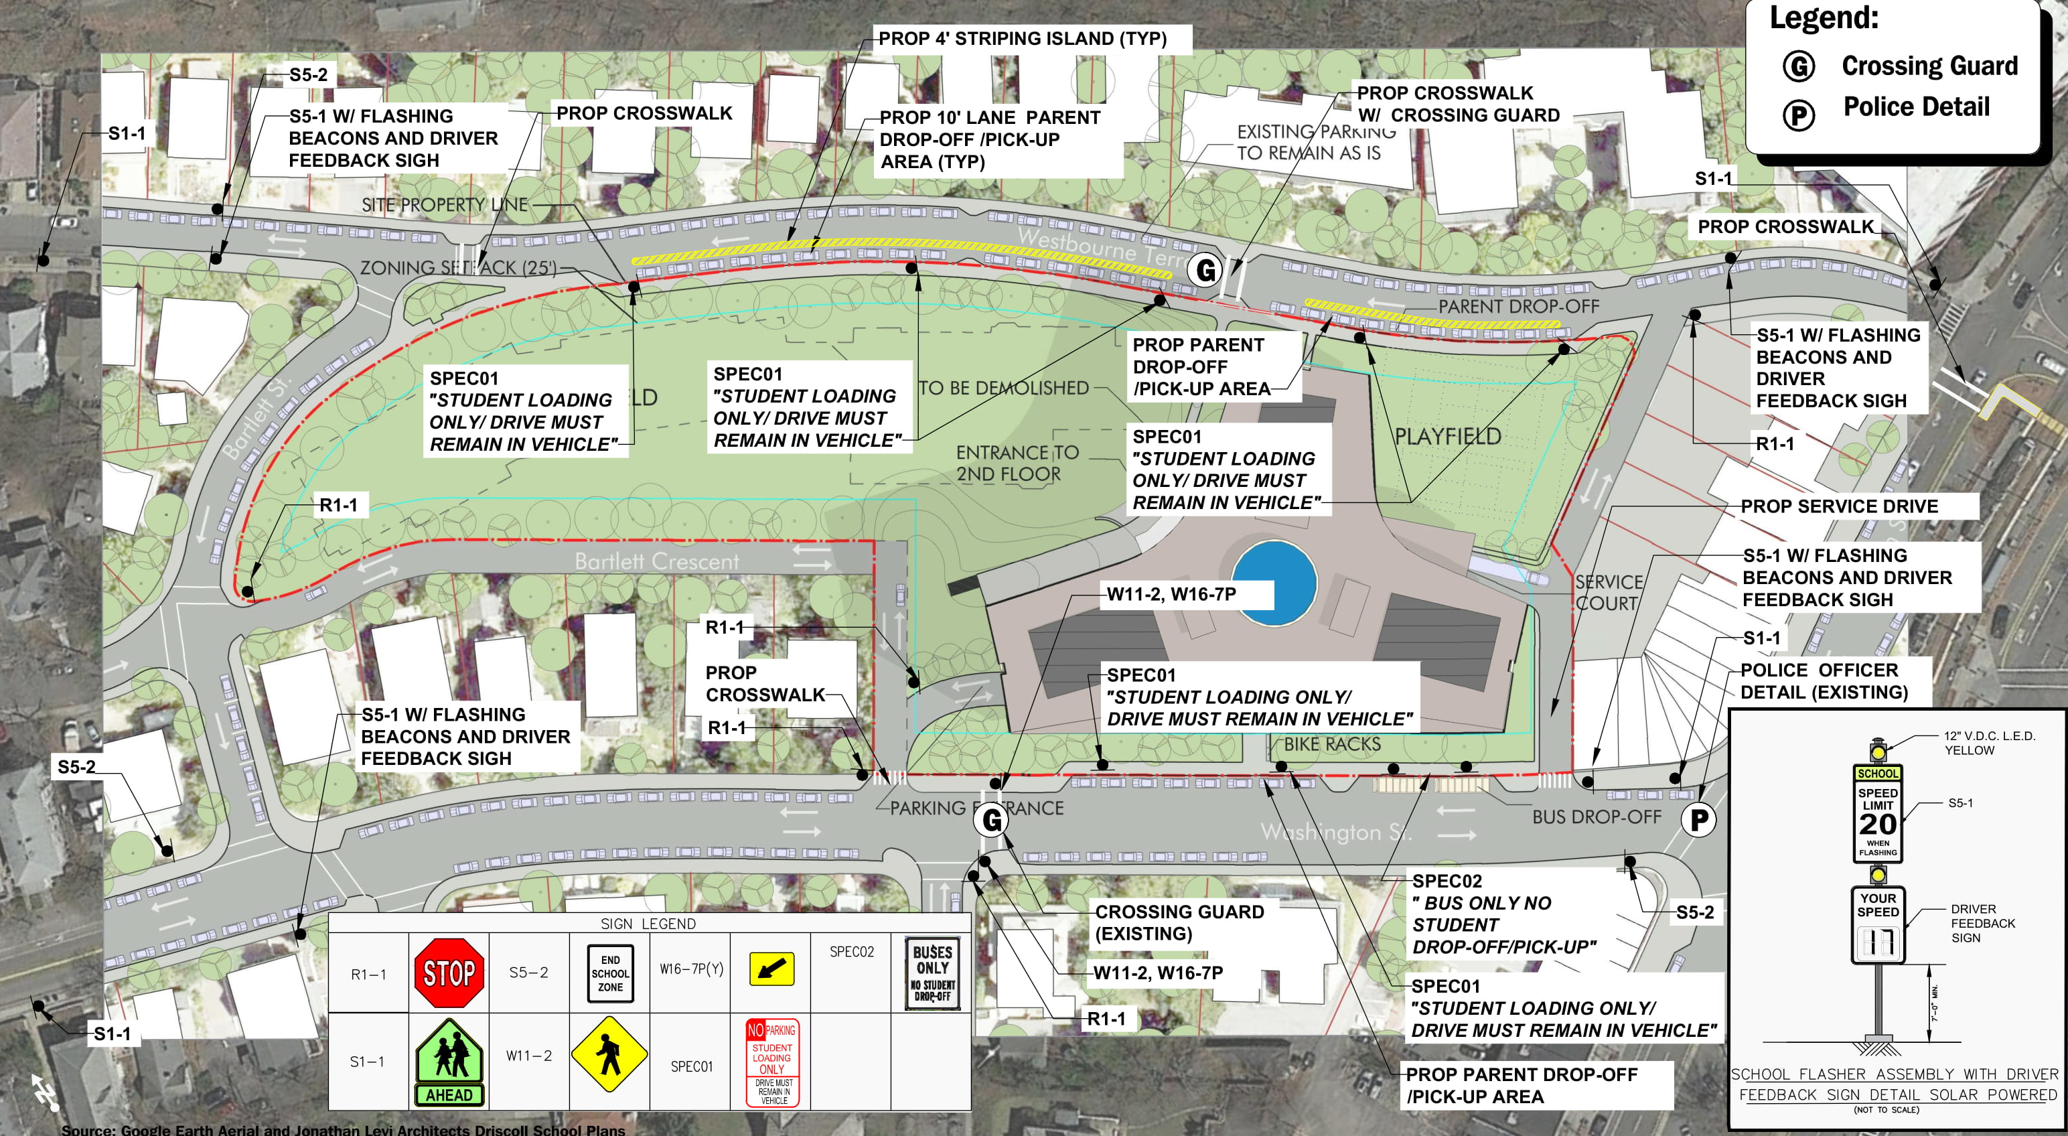
Recommendations
Pedestrian Access and School Signage Plan

Slide 13
Summary
  SUMMARY
Safe Environment Can Be Maintained
Delays and Queues - Limited to Short Periods
Traffic Conditions Will Be Manageable

